Slide 1
SAPTHAGIRI COLLEGE OF ENGINEERING
(Affiliated to Visvesvaraya Technological University, Belagavi & Approved by AICTE, New Delhi.)
Department of Information Science & Engineering
Mobile Application Development Lab
18CSMP68
Installation of Android studio
BY
Prof. SUDARSANAN D
Assistant Prof, Dept of ISE

Slide 2

What is Android?
Android is an operating system and programming platform developed by Google for smartphones and other mobile devices (such as tablets). ). It can run on many different devices from many different manufacturers.
Android includes a software development kit for writing original code and assembling software modules to create apps for Android users

Slide 3
Why develop apps for Android?
Apps are developed for a variety of reasons:
Addressing business requirements,
Building new services,
Creating new businesses, and
Providing games and other types of content for users.

Slide 4
Android Software Development Kit (SDK)
Android software development kit (SDK) to develop apps that take advantage of the Android operating system and UI.
The SDK includes a comprehensive set of development tools including
a debugger,
software libraries of prewritten code,
a device emulator,
documentation,
sample code, and tutorials
To develop apps using the SDK,
Use the Java programming language for developing the app and Extensible
Markup Language (XML) files for describing data resources.
To help you develop your apps efficiently, Google offers a full Java Integrated Development Environment (IDE) called Android Studio

Slide 5
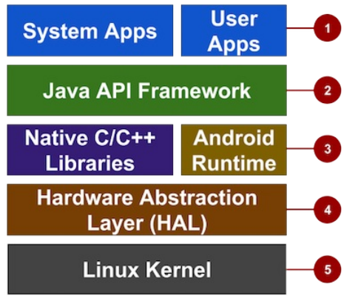
Android Architecture
Apps: Your apps live at this level, along with core system apps for email,
SMS messaging, calendars, Internet browsing, or contacts.
Java API Framework: All features of Android are available to developers through application programming interfaces (APIs) written in the Java language.
following APIs, which are useful for creating apps:
View System used to build an app's UI, including lists, buttons, and menus.
Resource Manager used to access to non-code resources such as localized strings,
graphics, and layout files.
Notification Manager used to display custom alerts in the status bar.
Activity Manager that manages the lifecycle of apps. Content Providers that enable apps to access data from other apps.
Many core Android system components and services are built from native code that require native libraries written in C and C++. These native libraries are available to apps through the Java API framework.
The HAL consists of multiple library modules, each of which implements an interface for a specific type of hardware component, such as the camera or bluetooth module.
Using a Linux kernel enables Android to take advantage of key security features and allows device manufacturers to develop hardware drivers for a wellknown kernel.

Slide 6
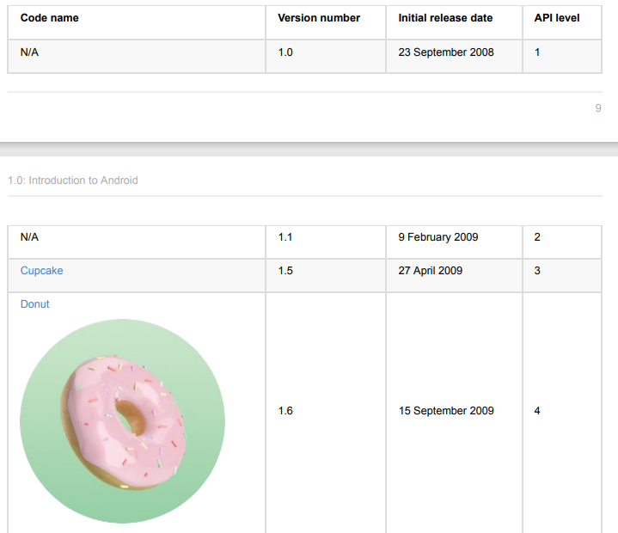
Android versions

Slide 7


Slide 8

GingerBread

Slide 9
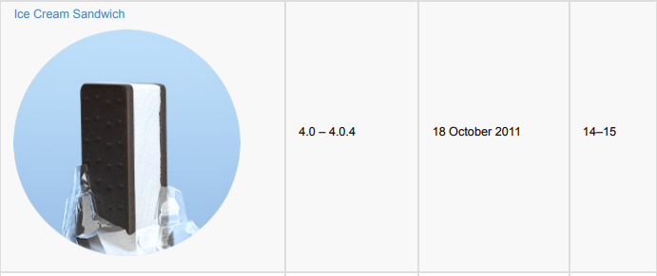

Jelly Bean

Slide 10


Slide 11
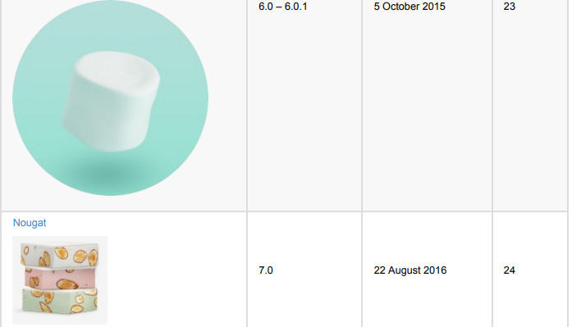
Marshmallow

Slide 12
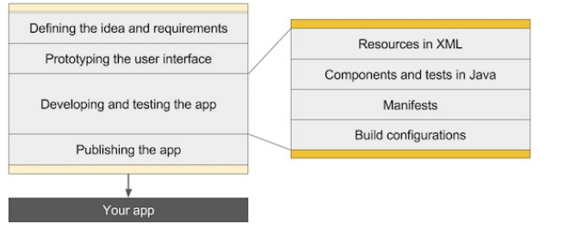
The development process

Slide 13
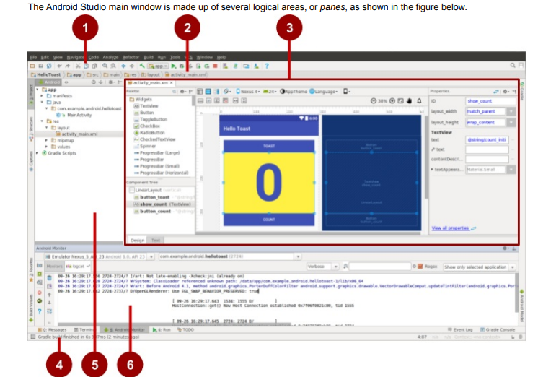
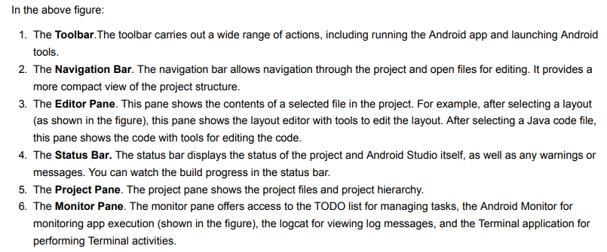

Slide 14
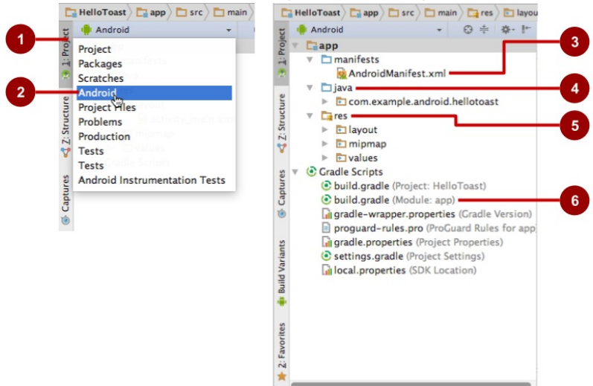
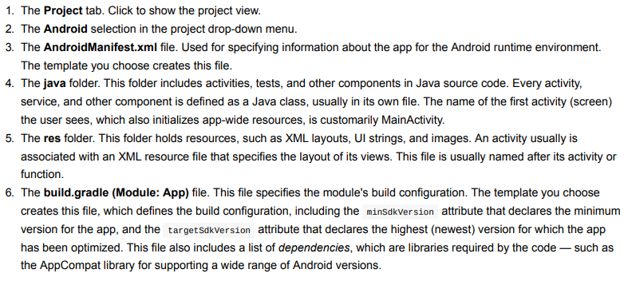
Exploring a project

Slide 15
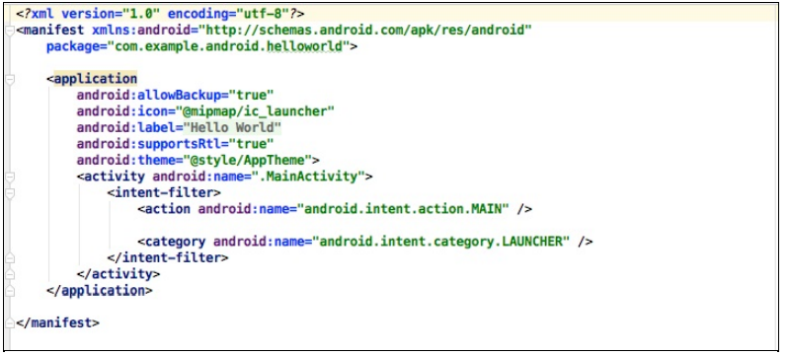
Activity_main.xml

Slide 16
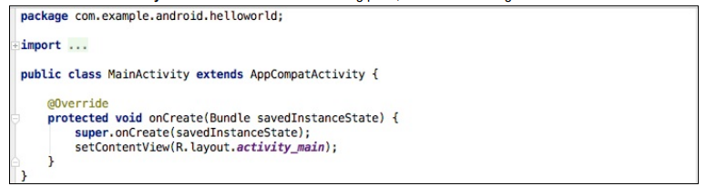
Viewing and editing Java code Main_Activity.java

Slide 17
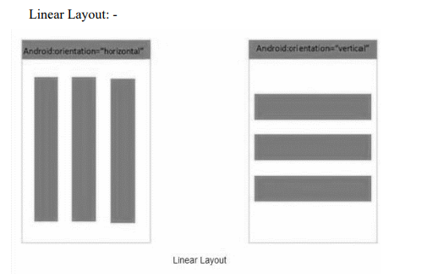
To develop and place the android components accurately on the display screen, android provides various layout managers.
Using View/View Group objects or you can declare your layout using simple XML file main_layout.xml which is located in the res/layout folder of your project.
layouts defined in XML file. A layout may contain any type of widgets such as buttons, labels, textboxes etc. Layout Attributes Each layout has a set of attributes which define the visual properties of that layout
Types of Layout
Linear Layout
Vertical Linear layout
Horizontal Linear Layout

Slide 18
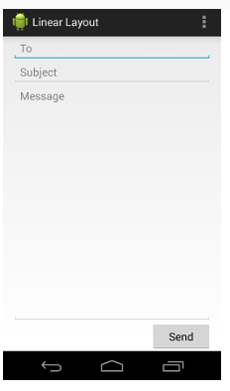
example

Slide 19

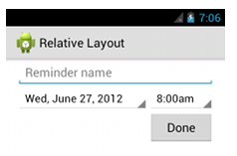
2. Relative layout.
Android RelativeLayout enables you to specify how child views are positioned relative to each other. The position of each view can be specified as relative to sibling elements or relative to the parent.
Example:

Slide 20
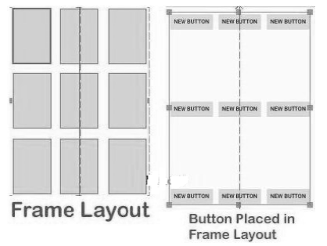

3. Frame Layout:

Slide 21
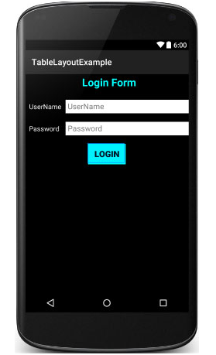
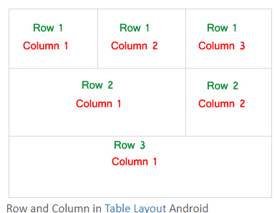
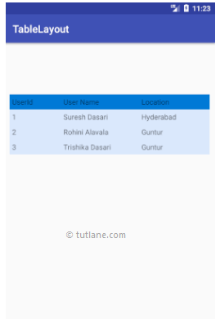
4. Table Layout

Slide 22
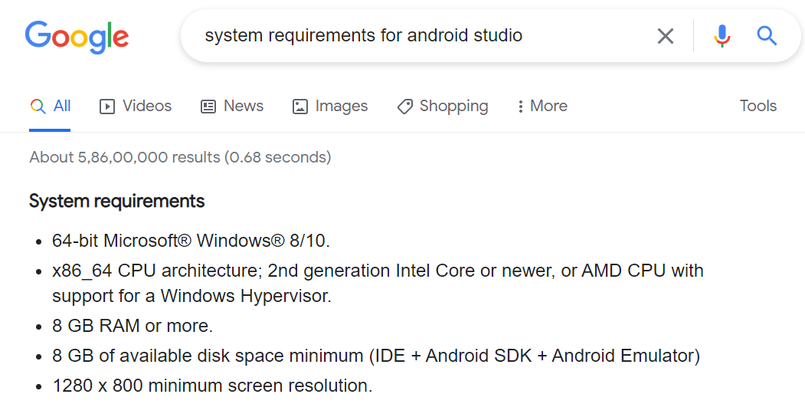
INSTALLING AND RUNNING APPLICATIONS ON ANDROID STUDIO
Step 1 - System Requirements:

Slide 23
System Requirements
The required tools to develop Android applications are open source and can be downloaded from the Web. Following is the list of software's you will need before you start your Android application programming.
Java JDK5 or later version
Java Runtime Environment (JRE) 6
Android Studio

Slide 24
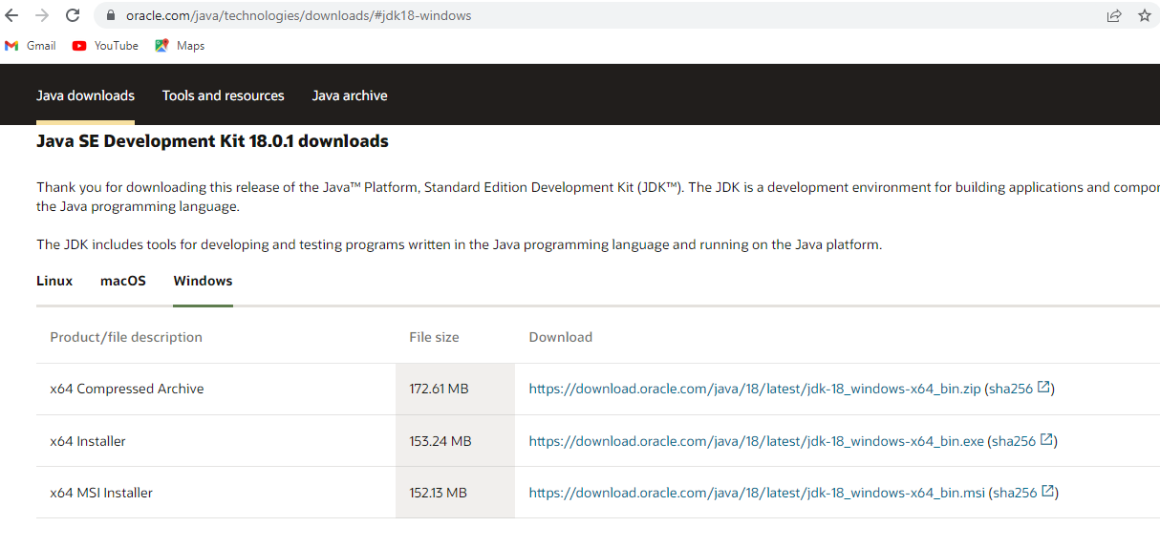
Installing the Java Development Kit on Windows
http://www.oracle.com/technetwork/java/javase/downloads/index.html

Slide 25
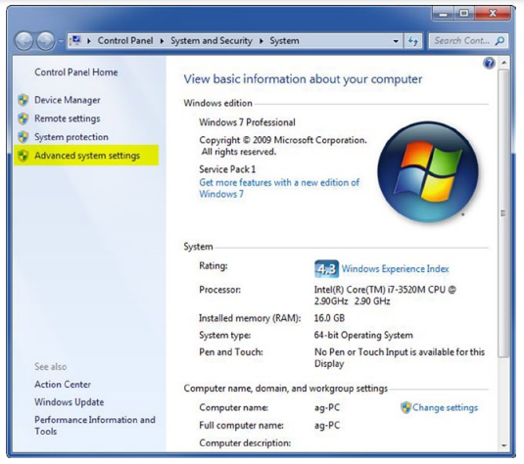
Configuring Environmental Variables on Windows
Control panel→System and Security→System→Advanced System setting

Slide 26
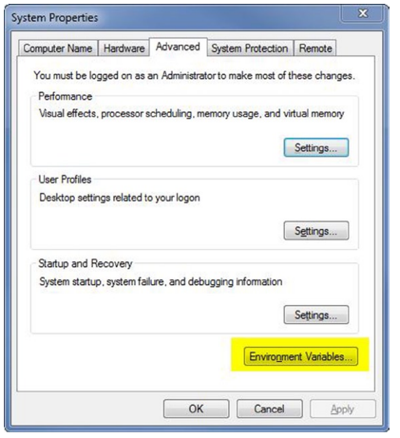
SELECT ENVIRONMENT VARIABLE

Slide 27
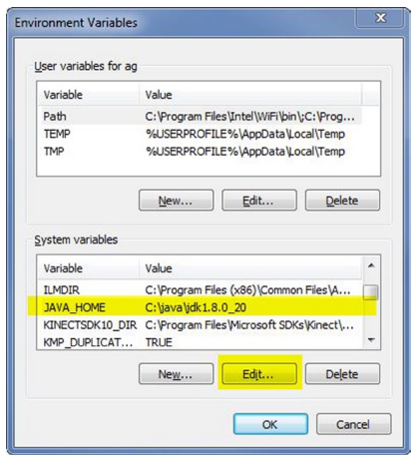
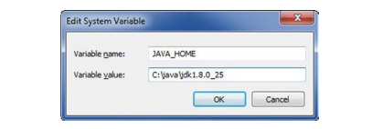
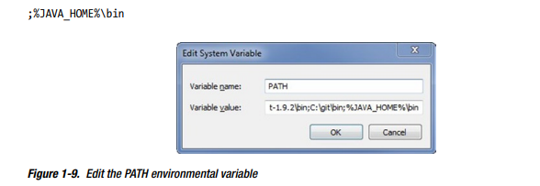

Slide 28
Installing Android Studio
http://developer.android.com/sdk/installing/studio.html

Slide 29
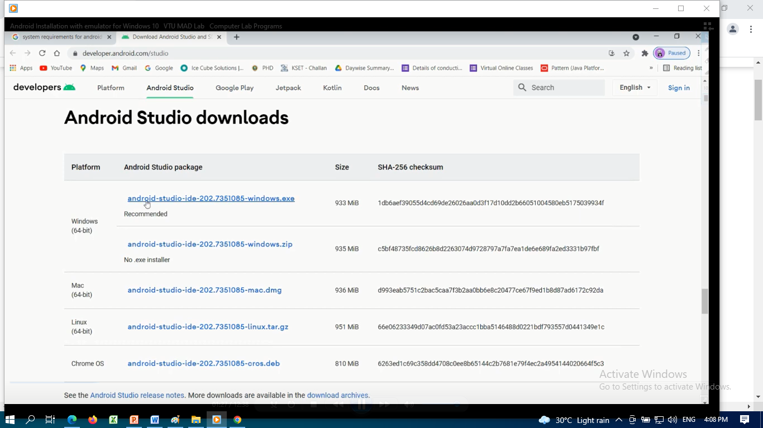
Step 2 - Setup Android Studio

Slide 30
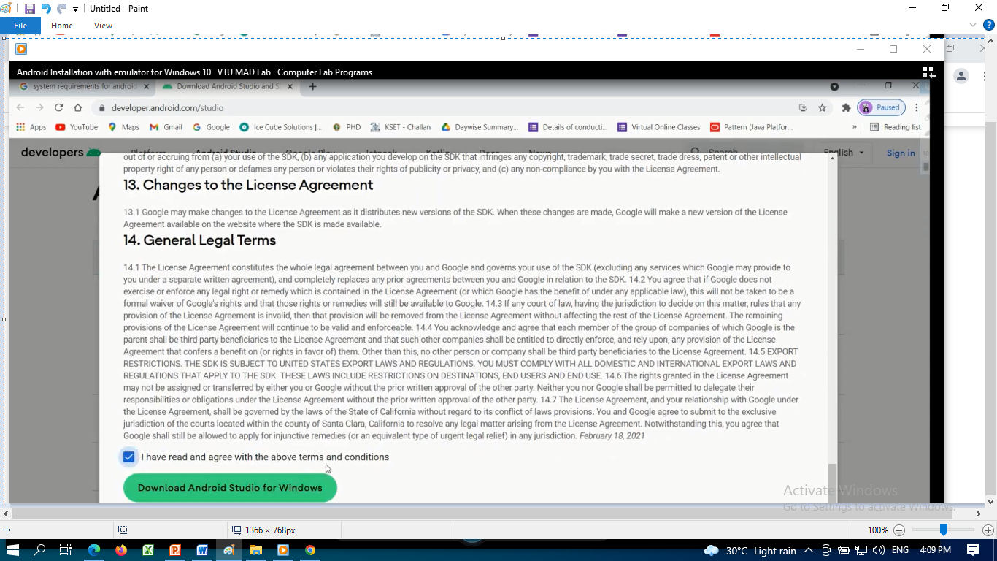

Slide 31
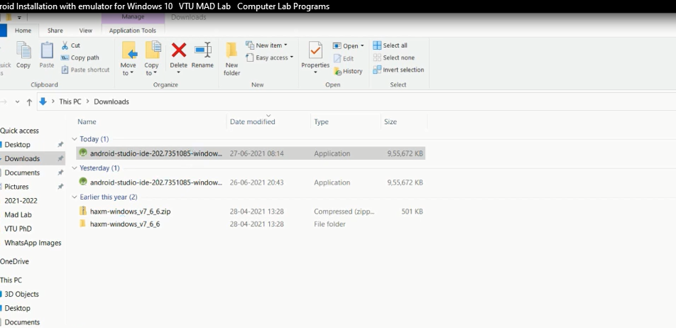
After downloaded the android studio ,click the exe file

Slide 32
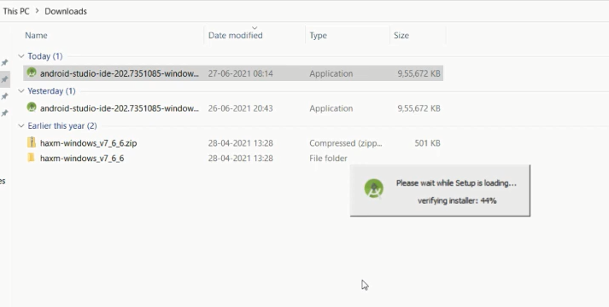

Slide 33
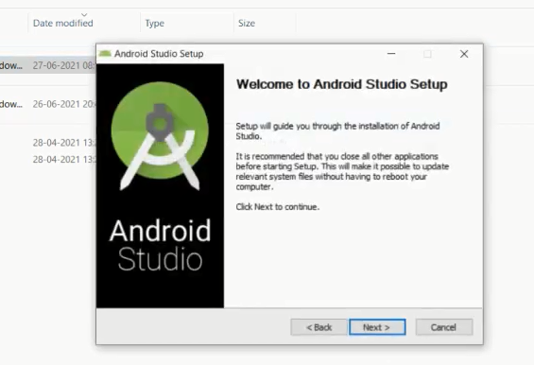
Click next button

Slide 34
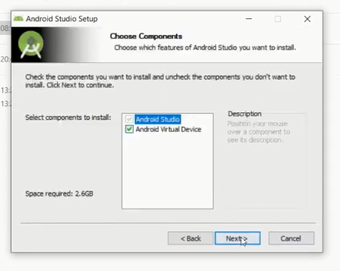
Click Next

Slide 35
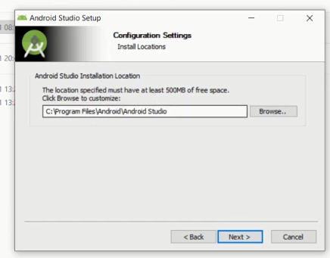
Click Next

Slide 36
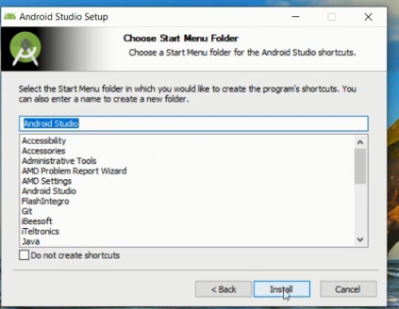
Click install

Slide 37
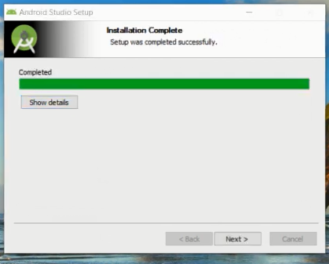

Slide 38
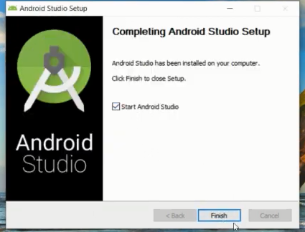

Slide 39


Slide 40
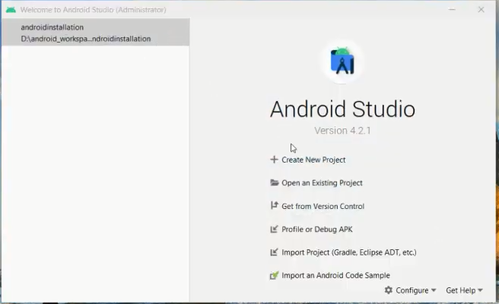
Create New Project
click

